Slide 1
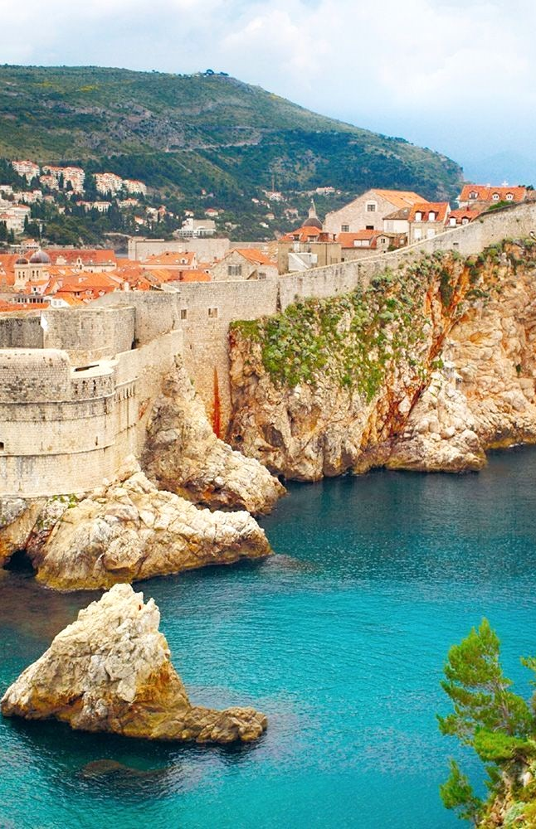
SEGMENTATION OF CROATIAN CITIES
Andrea PIRSA

Slide 2
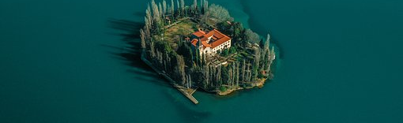
About PROJect
Croatia is a Central European and Mediterranean country with a long maritime border with Italy in the Adriatic Sea. Croatia has a big challange to make strong offer for tourists from different cultures. One of the challenges is to show tourists what the country has and what are some of the specialties of each country region. Another challenge have Croatian caterers when they need to create offers for tourists and open the right type of restaurant in right town.

Slide 3
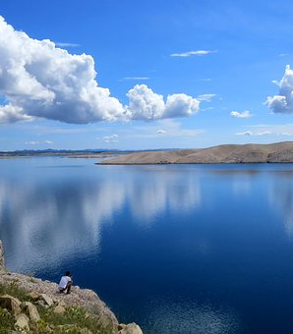
Goals
show segmentation of Croatian cities based on the collected venues data
predict which city has some specific type of restaurant based on some other venues data
-This solutions could help tourists to find out how similar some cities are and show investmens where to open some type of restaurant

Slide 4
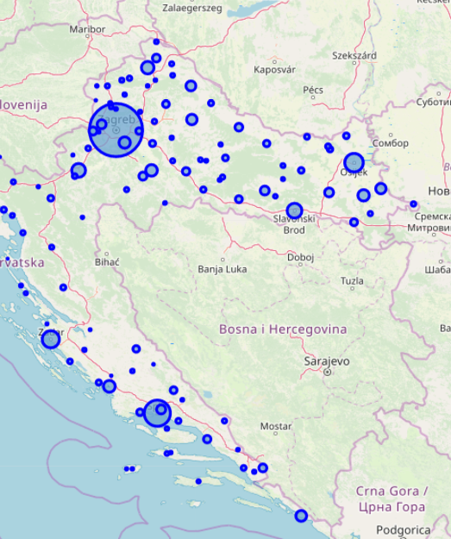
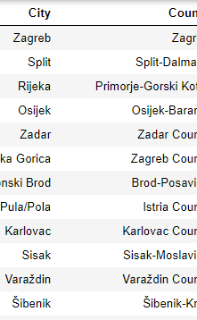
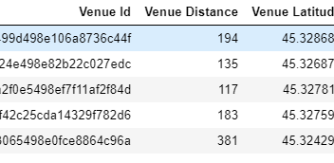
DATA
Data about Croatian cities from Wikipedia
Longitude and latitude if each city
Venues data:
From https://api.foursquare.com was collected data about the venues which are in the radius of 5000 meters of each city in Croatia
Dataset with 14130 venues

Slide 5
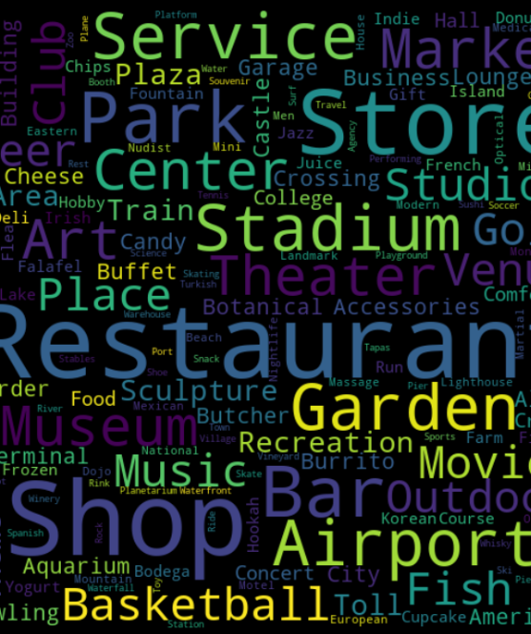
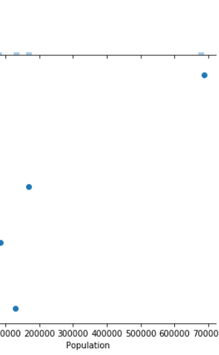
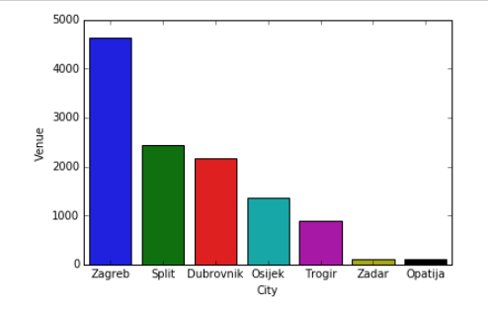
DATA analySis
few cities with a lot of venues and then there is strong decrease in number of venues
Removal of cities with less than 10 venues
65 cities left in dataset
Strong correlation between number of venues and size of population in the city
WordCloud of venue category names and number of venues per categories
Joining of some small categories in one
Aggregation of data on city level

Slide 6
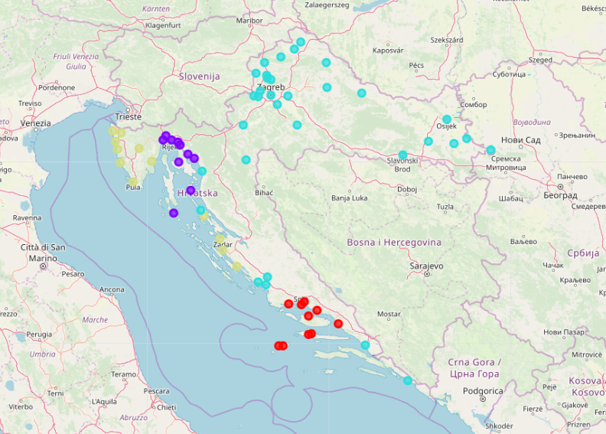
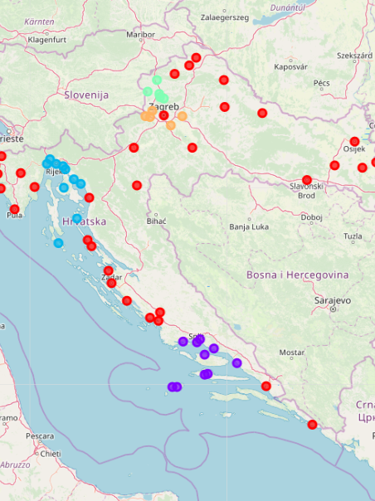
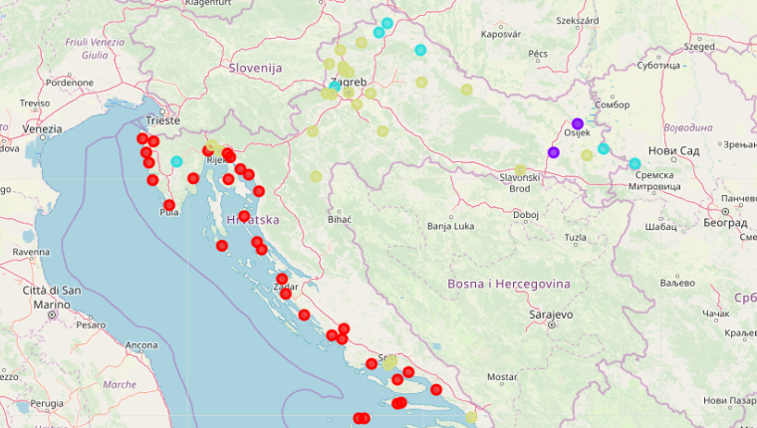
SEGMENTATION of cities
Clustering data in chosen number of clusters with sklearn Kmeans implementation
Segmenation on 2 datasets:
All prepared varibles
Only „touristic” variables
Results of clusters on the first dataset with 4 clusters are overlapping with some geographical and traditional regions in Croatia
Clustering on the first dataset with 5 clusters isolated some specific parts of regions in Croatia
Segmentation on „touristic” dataset separated Croatia on continental and seaside part with some food and culture caracteristics

Slide 7
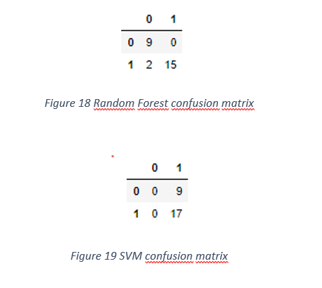
Restaurant predictions
Based on the prepared dataset with variables which are „tourist attractive“ models have try to predict if there is any Mediterranean restaurant in cities of Croatia
Random Forest Classifier with 250 estimators and default sklearn SVM
Random Forest is good in predicting both classes and SVM for all cases chose the same class
0.9375 F1 score and 0.9207 Jaccard score are showing that Random Forest is pretty good choice

Slide 8
Venues data has very big potential for many different purposes and analysis
Segmentation depends on the input data and based on the purpose of segments input data should be selected
Results have shown that Croatia has few interesting regions and for tourist this model could be some kind of trip advisor
Random Forest on small dataset showed that this kind of model could help investors to find the right place for opening some type of restaurant, bar, shop…
Development of some customized model which could help tourists with recommendations based on some real-time inputs could be nice extension to this project

